Slide 1
Online Groceries Features Review
Q2 2021

Slide 2
» Site Comparison Review
» Metrics
Hompage – The 1st impressions customers have when they see the site
Registration/Sign in – How easy is it to sign up or login for customers?
Navigating the site –Can customers find what they want?
Product Pages – Is the product well displayed with all the information customers need?
Placing an order – Can the customer book a slot and get through checkout easily?
Site Experience – Does the customer have a good overall experience on the site?
» Summary
Homepage (Based on the Homepage design, features and ease of use – Slide 3) – Redesign on web completed to include focus on slot booking, as requested by customers. Focus: Seasonal, promotional, multiple product spotlights, recipes
Registration (Based on the registration page – Slide 3)– We currently ask for a customers postcode 3 times, whereas our competitors have streamlined postcode check into registration and offer services such as register with Google, Facebook and Paypal
Navigating the site (Sub metrics, Navigation, Search, Favourites and lists, Taxonomy and filters – Slide 4) - Customers find our navigation overly complex, especially on app… Directly comparing us unfavourable with the Tesco App. – 57% of our cart adds came from search. Our search is outperforming competitors by offering auto-correct, enhanced search, recipe and product results and multiseach.
Product Page (Sub metrics, Product Detail Page and Product Modules – Slide 3) – 32% of all visits are to product pages but only 4.7% of cart adds come from these pages. Ocado and Morrisons are offering more functions on these pages than Asda.
Placing an order (Sub metrics, mini trolley, before you go, book slot, linksave and checkout – Slide 6) – We currently offer the further slot horizon, allowing for 21 days in advance along with Tesco, but our app is a 3 day against all other competitors 1 day horizon. While we have the shortest checkout process, other competitors are more focused on upselling and offering wider payment options or loyalty incentives such as clubcard or nectar points
Site Experience (Sub metrics, Content, Personalisation, Monetisation, Recipes and Accessibility – Slide 5) – Site wide personalisation by inhouse solution for each customer. Competitors use standard “new products” or “top sellers”. Competitors are more active than Asda in personalised email campaigns. No other competitor offers funded media, content and sponsored products on both web and mobile app. None of our competitors currently offer recipes on app, while we do. Recipes accounts for 38% of page views but only 0.2% of cart adds, potential to add recipes to product pages
Notes:
Remove Waitrose and Iceland

Slide 3
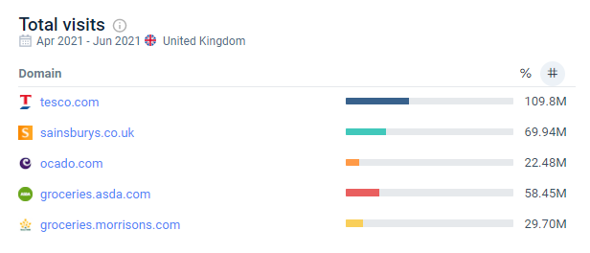
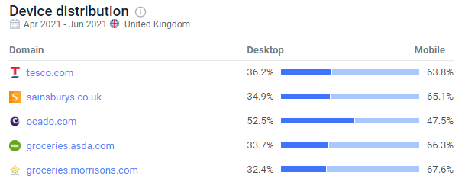
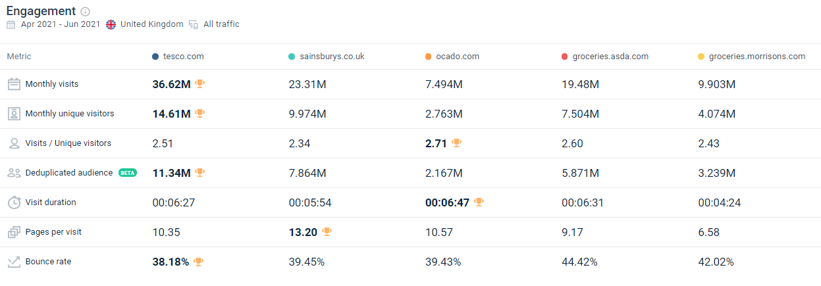
» Competitor Traffic Data

Slide 4
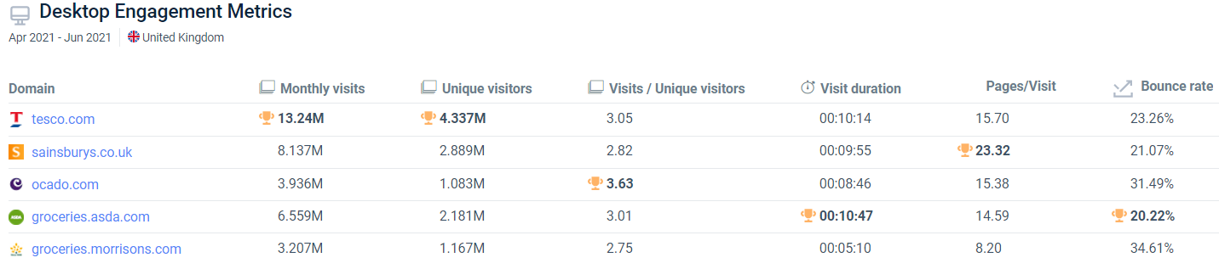
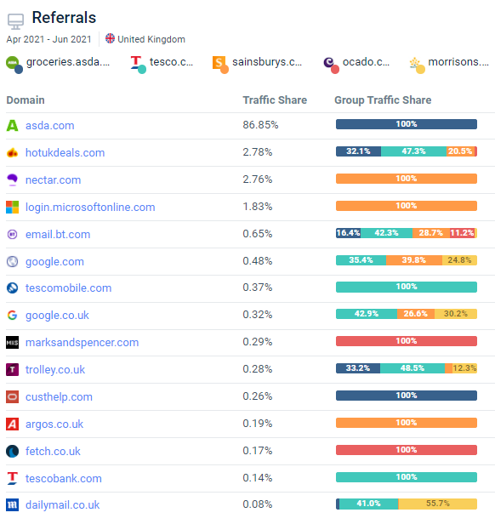
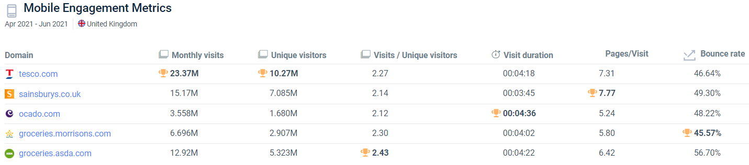
» Competitor Traffic Data

Slide 5
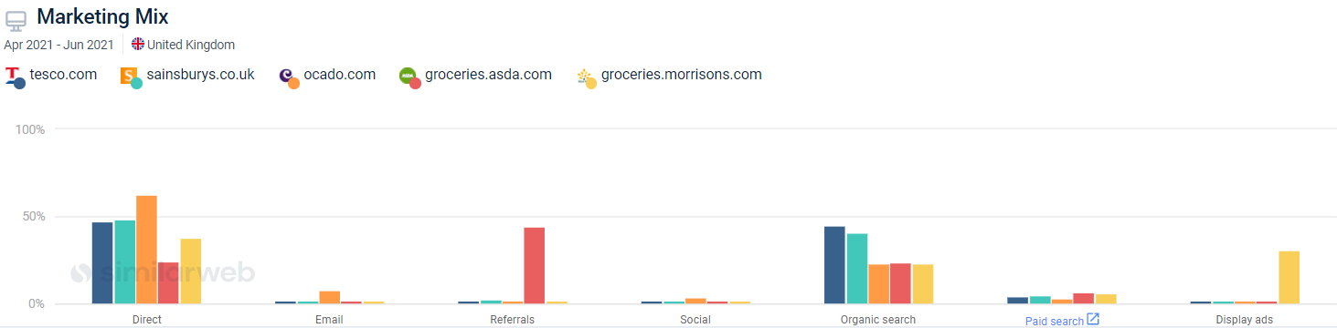
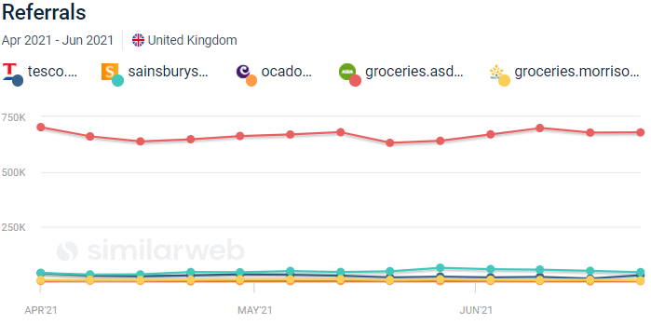
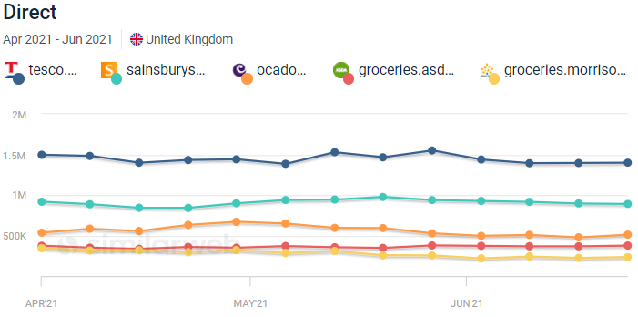
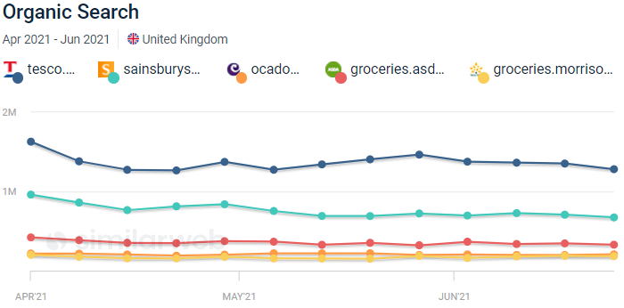
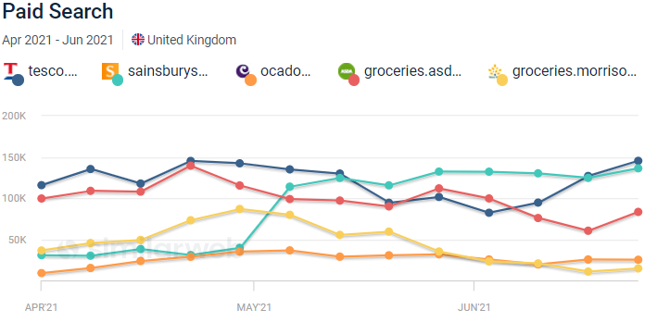
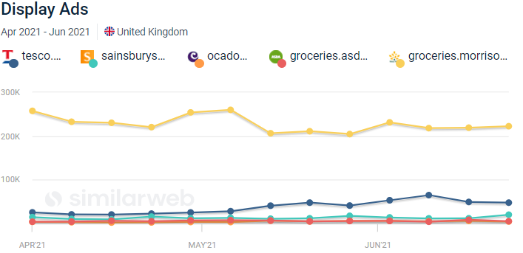
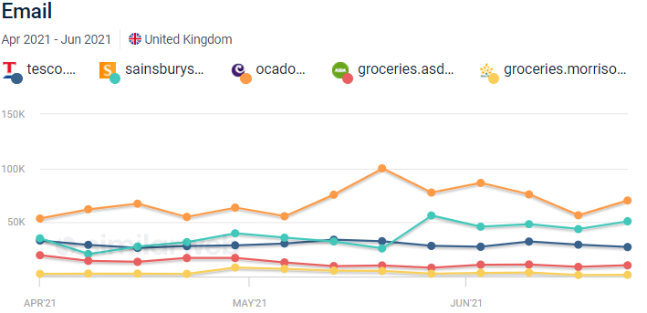
» Competitor Traffic Source Data

Slide 6
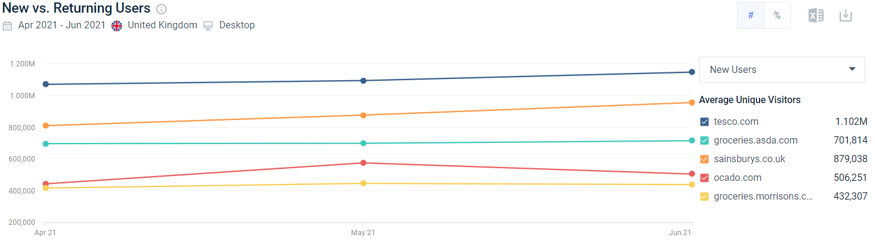
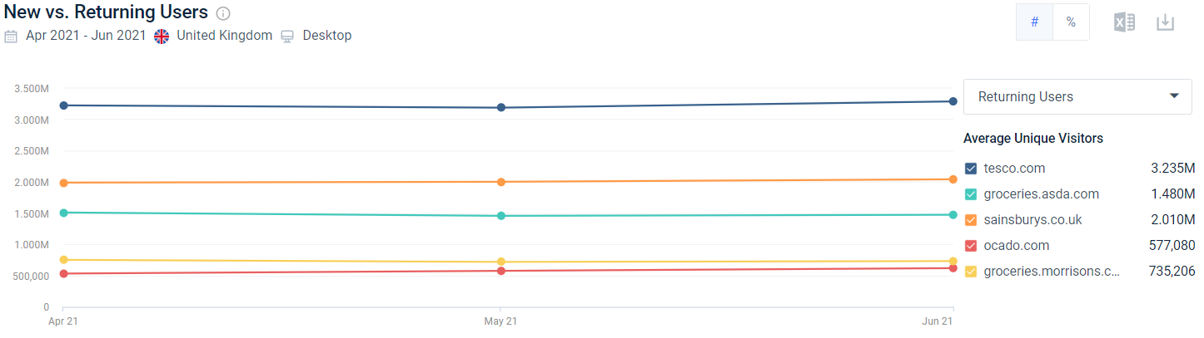
» New Vs. Returning Customers

Slide 7

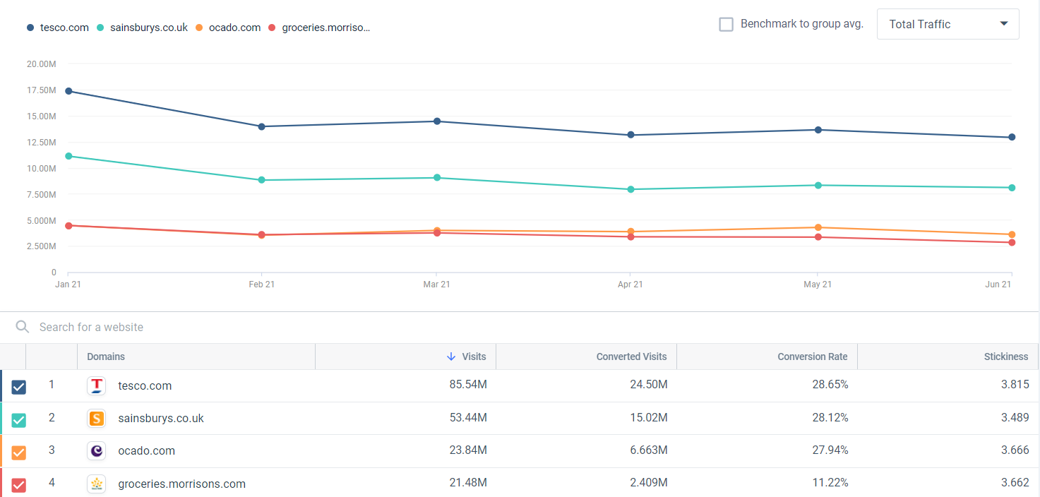

Slide 8
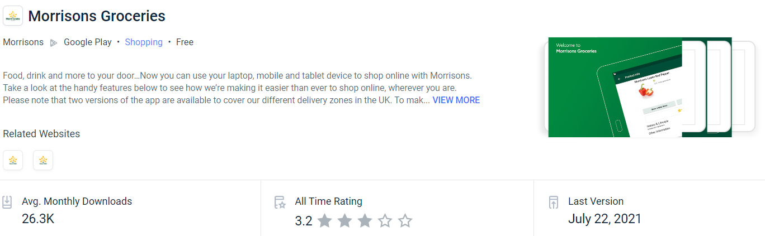
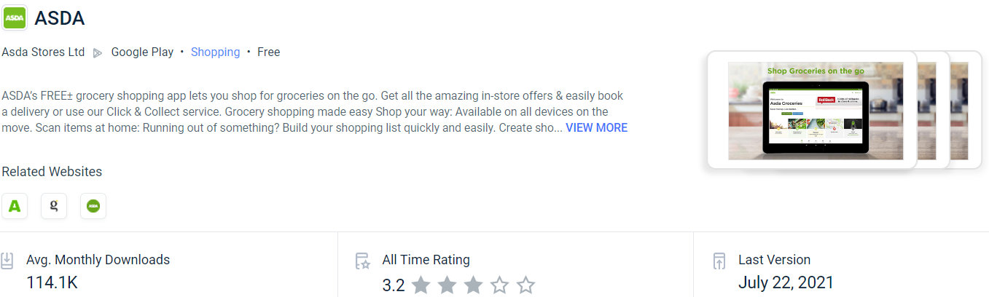
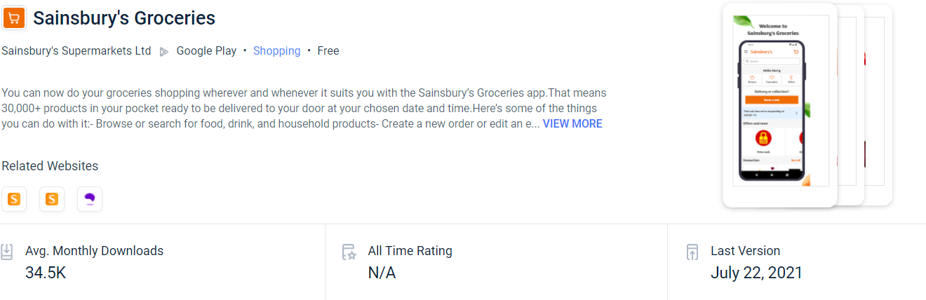
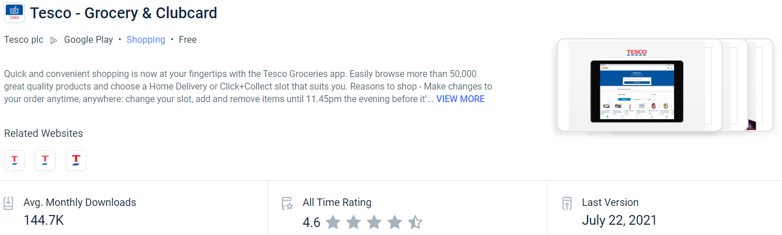
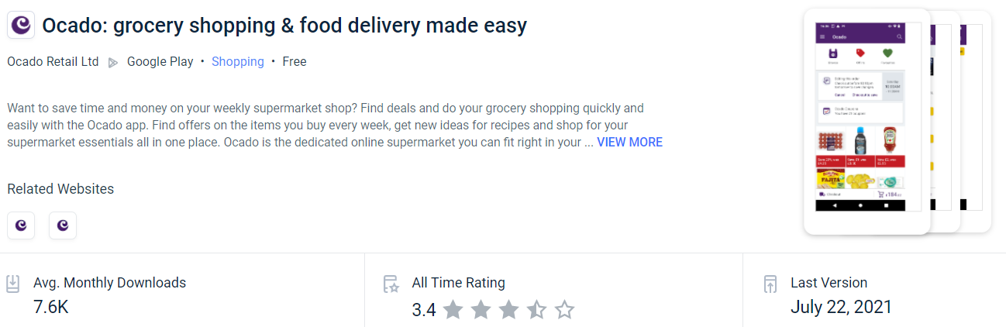
» Competitor Apps Performace

Slide 9
» Market Share Data

Slide 10








» Ocado Headlines

Slide 11

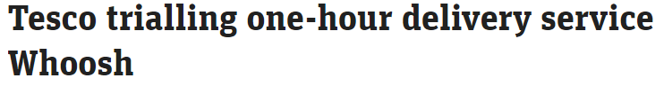
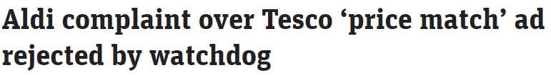



» Tesco Headlines

Slide 12


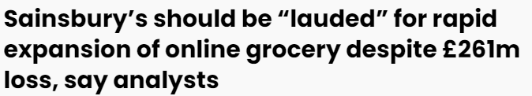
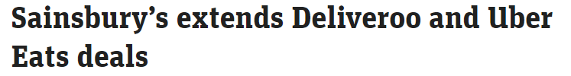
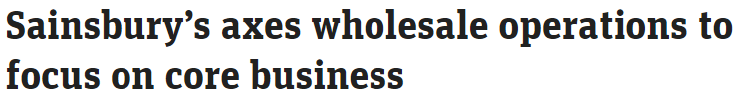
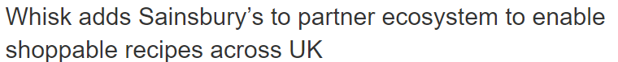
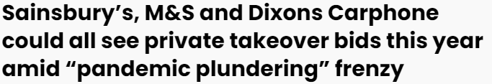
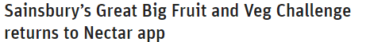
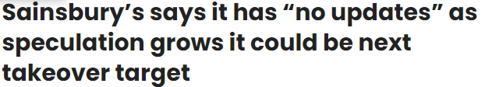
» Sainsburys Headlines

Slide 13




» Morrison’s Headlines

Slide 14








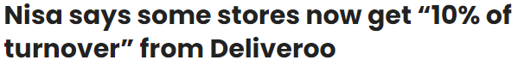



» Other Headlines

Slide 15
» Homepage
Asda
Tesco
Sainsbury’s
Morrisons
Ocado
Waitrose
Iceland
Co-Op
AmazonFresh
Walmart
Groceries
Homepage
Focus: Seasonal,
promotional, multiple
product spotlights,
Recipes. Updated focus on slot booking for customers
Focus: book slot &
start shop. Offers,
promotional, product
spotlight
D Focus: Seasonal,
promo, offers,
inspiration;
MR Focus: book slot
& start shop. Offers,
seasonal, product
spotlight removed
D Focus: Offers,
seasonal, long
product list;
MR Focus: book slot
& start shop. Offers,
seasonal, product list
removed
D Focus: Offers,
seasonal, long
product list, promo;
MR Focus: book slot
& start shop. Offers,
seasonal, product list
removed
D Focus: book slot
& start shop, browse
categories, long
product list;
MR Focus: book slot &
start shop, product list
Focus: Promotional,
popular categories,
featured offers, no
product lists.
Focus: Product
spotlights
Focus: Horisontal
scrolling product lists,
multiple easy links to
get shopping.
Focus: Promotions,
seasonal, services.
Popular categories,
offers, no product
lists. Very visual.
» Registration
Registration
Single email and
password, strength
checker, postcode
only - remaining
details in account
or checkout, opt-in
marketing choice
Single email and
password, full details
required,
multiple opt-in
marketing choices -
some auto selected
Multi-step process,
external email
verification, full
details required,
opt-in marketing
choice
Register with
Facebook/AppleID,
postcode check, full
details, single email
and password, opt-
in marketing choice,
reCAPTCHA
Register with
Facebook/Paypal/
AppleID, single email
and password, name,
postcode, opt-in
marketing choice
Full details required, Full details required,
postcode check, 2x postcode check, single
2x Email and 2x
password,full
details required for
membership,opt-in
marketing
Name, email, 2x
password, email
verification OTP,
remaining details on
log-in
Name, single email
and password, opt-in
marketing choice auto
selected, remaining
details in account or
checkout
email and single
email and password,
password, multiple opt-in marketing
opt-in marketing
choices
choice auto selected,
reCAPTCHA
» Product Pages
Product
detail page
Image zoom, no
breadcrumb, add to
favs/list, nutritional,
icons
recommendations
rating and reviews,
product info, branded
content
Simple image enlarge,
nutritional, rating and
reviews, product Info,
recommendations,
view rest of shelf
Simple image enlarge,
rating and reviews,
product Info,
nutritional
Image enlarge,
nutritional, icons,
recommendations,
sponsored products,
rating and reviews,
product info, related
tags, recipes, report
incorrect info, add
to favs/list, add to
regulars
Image enlarge,
nutritional, icons,
recommendations,
sponsored products,
rating and reviews,
product info, related
tags, recipes, report
incorrect info, add
to favs/list, add to
regulars,
Simple image enlarge,
add to favs/list,
nutritional,
rating and reviews,
product info, limited
iconography
Simple image enlarge,
add to favs,
nutritional, rating and
reviews,
product info,
recommendations
Product info,
nutritional
Image zoom, multiple
product images, rating
and reviews, customer
questions, product
info, nutritional,
recommendations,
branded content,
report incorrect info,
more ways to buy
(Morrisons)
Image zoom, multiple
product images.
Ratings, reviews,
aspect filters,
comments. Add to
lists. Link to brand list
and related products,
recommendations.
Nutritional. Report
incorrect info. Icons
Product module
Multiple add, clear
promos, iconography,
rating links to review
on PDP, add to favs/
list, D: variable width.
OOS: Flag + alt,
Unavailable: Flag only
Multiple add - clear
affordance, promo
details, limited
iconography, link to
rest of shelf, write
a review, variable
width/ height, call out
Multiple add,
promo details, limited
iconography, rating/
write a review, dietary
profile warning, D:
variable height, fixed
width;
OOS/Unavailable:
None displayed
Multiple add,
promo details, limited
iconography, rating –
no totals links to PDP,
add to favs/list,
D: variable width;
OOS/Unavailable:
Flag and link to
alternatives
Multiple add,
promo details, limited
iconography, rating
links to PDP, add to
favs/list,
D: variable width;
OOS/Unavailable:
Flag and link to
alternatives
Multiple add - clear
affordance,
promo details, rating,
add to favourites,
D: variable width;
OOS/Unavailable:
None displayed
Multiple add,
promo details plus
linksave reminder,
rating, add to
favourites,
D: variable width;
OOS/Unavailable: Flag
only
Multiple add,
promo details,
D: variable width;
OOS/Unavailable:
None displayed
Single add, rating,
promo detail,
D: variable width;
OOS/Unavailable:
None displayed
No CTA/Add option
- add from PDP,
rating, promo detail,
availability for
delivery/collection,
D: variable width;
OOS/Unavailable:
None displayed

Slide 16
» Navigating the site
Asda
Tesco
Sainsbury’s
Morrisons
Ocado
Waitrose
Iceland
Co-Op
AmazonFresh
Walmart
Navigation
D: Scrolling, 4-level
hover mega menu.
MR: Drilldown nav.
View all at aisle/shelf
level, explore buttons
D: Scrolling, 3-level
click mega menu.
MR: Accordion nav.
View all at dept level
D: Persistent, 3-level
hover mega menu.
MR: Drilldown nav.
View all at cat/dept
level
D: Persistent, 3-level
hover mega menu.
MR: Drilldown nav.
View all at cat/dept
level, featured links,
D: Persistent, 3-level
hover mega menu.
MR: Drilldown nav.
View all at cat/dept
level, featured links,
D: Persistent, 3-level
click mega menu.
MR: Drilldown nav.
View all at cat/dept
level
D: Scrolling, 3-level
click mega menu.
MR: Drilldown nav.
View all at cat/dept
level, featured links
Persistent, 2-level
click accordion. View
all at dept/aisle level,
not accessible
D: Scrolling, 2-level
hover dropdown,
explore buttons,
drilldown horisontal
scrolling spotlights
D: Persistent,
collapsed 2-level
hover mega menu.
MR: Drilldown nav
Search
DRT, auto-correct,
multi-search, recipe
and product results. Personalised search
D: enhanced auto-
complete.
MR: no EAC
Basic auto-complete,
auto-correct, multi-
search, excellent
search refinement
Basic auto-complete,
auto-correct, multi-
search
D: Auto-complete,
auto-correct, iterative
search, related terms,
multi-search. MR:
Basic auto-complete
only
D: Basic auto-
complete, auto-
correct, iterative
search, multi-search.
MR: Basic auto-
complete only
Basic auto-complete,
auto-correct, multi-
search, remove words
Enhanced auto-
complete, auto-
correct, suggested
terms
Basic auto-complete,
auto-correct
Auto-complete, auto-
correct
Auto-complete,
auto-correct, related
brands, related search
terms, rest of shelf
Favourites
and lists
Add from product,
favourited and
Your Regulars,
recipes; sort/filter.
Shopping lists –
Add from product,
highlight offers, add
to basket
Fav: Online/in-store
purchases from last
13 months, filter by
category. My Usuals
– items regularly
purchased online
Shopping lists – not
available, work in
progress
Nectar Card,
based on frequently
bought items,
previous orders tab,
no shopping lists
Add from product and
frequently bought
items, search for
products, sort. User
created list with
frequency setting,
offers
Add from product and
frequently bought
items, search for
products, sort. User
created list with
frequency setting,
offers
Add from product,
online/in-store
purchases, sort/filter,
no frequently bought,
shopping lists – add
from PDP
Add from product,
favourited items only.
Frequently Bought
– items regularly
purchased online. No
shopping list
None
None
Past Purchases –
previously bought
items. No shopping
lists.
Add from product
to primary list, no
favourites page. Buy
again – previously
bought items.
Shopping lists – add
from PDP,
search for products,
collaboration
Taxonomy and
product lists
60 products per
page, pagination,
sort/filter, explore
and refinement links
recommendations.
Product modules:-
D: max 6 per row. MR:
1 per row
24-48 products per
page, pagination,
sort/filter,
recommendations.
Product modules:-
D: max 4 per row. MR:
1 per row
48-120 products per
page, pagination, list/
module view, sort/
filter.
Product modules:-
D: max 4 per row. MR:
1 per row
Lazy load, sort/filter,
refinement links,
arranged by promo
type – offer/oos, new/
oos, all other/oos.
Product modules:-
D: max 10 per row. MR:
1 per row
Lazy load, sort/filter,
refinement links,
arranged by promo
type – favs, offer/oos,
new/oos, all other/
oos.
Product modules:-
D: max 10 per row. MR:
1 per row
48 products per page,
load more button,
sort/filter, refinement
links.
Product modules:-
D: max 6 per row. MR:
1 per row
24 products per page,
pagination, sort/
filter, popular brands/
images, refinement
links, list/module view
Product modules:-
D: max 4 per row. MR:
1 per row
16 products per
page, load more
button, no filters, no
breadcrumb.
Product modules:-
D: max 4 per row. MR:
2 per row
24 products per page,
pagination. sort/filter.
Product modules:-
D: 4 per row.
MR: Defaults to App
40 products per page,
pagination, sort/
filter, related brands/
searches/terms,
refinement links, list/
grid view.
Product modules:-
D: max 5 per row. MR:
1 per row
Product Spotlight
pages
D: 7 per row
Filters
and sorting
Multi-select drop-
down dietary &
lifestyle filters, single-
select brand; sort incl.
basic + nutritional;
drop-down modals
require scrolling
Collapse/expand
multi-select filters
incl. category, brand,
new, offers and
favourites, single
select dietary &
lifestyle; basic sort
Collapse/expand
multi-select filters
incl. dietary & lifestyle,
type, brand, new,
offers and favourites;
comprehensive sort
incl. favs first, popular,
rating, new
Multi-select left-side
filters incl. brand,
dietary & lifestyle,
new, offers;
sort incl. favs first, life
(short to long), rating,
etc
Multi-select left-side
filters incl. brand,
dietary & lifestyle,
new, offers, own
brand; sort incl. favs
first, life (short to
long), rating, etc
Multi-select filters
incl. Waitrose brand,
dietary, offers;
refinement links; sort
incl. popular, rating,
etc
Multi-select left-side
filters incl. price,
brand, type/ flavour/
bigger pack; sort
incl. popular etc.;
refinement links; no
nutritional filters
None
Multi-select left-hand
filters, review and
price refinement
Multi-select left-side
filters incl. brand,
rating, price, offers,
type, dietary;
refinement links incl.
brands, related, store
availability; sort incl.
popular, rating, new
etc.

Slide 17
» Site Experience
Asda
Tesco
Sainsbury’s
Morrisons
Ocado
Waitrose
Iceland
Co-Op
AmazonFresh
Walmart
Content
Content throughout
the site, integrated in
taxonomy PLPs, PDPs
and content pages.
Templated media
and coded content
structure, flexible
richtext templates,
expandable media.
Video content.
Mainly localised
accessible from nav,
little integration in
taxonomy pages.
Templated pages/
elements with same
layout format, images
drivers to content
pages with product
spotlights.
Some content in
taxonomy pages,
image drivers on
seasonal pages
to product listing
pages - templated
format. Gallery type
inspirational content/
images including user
created content. Video
content.
Content throughout
the site, integrated in
taxonomy and content
pages. Templated
header and image
link content relatively
a flexible format
to accommodate
images, keeps to a
similar style, bespoke
colorways
Little integration in
taxonomy pages.
Mostly localised
Shop/content pages.
Distinct gallery
template with some
flexibility in the
arrangement of
images, links and
colourways.
Some integration
in taxonomy pages,
limited subtle image
drivers present.
Localised content
seems relatively
flexible in layout,
following a distinct
visual style –
predominantly using
images
Some content
integration in
taxonomy, image
links on seasonal
event pages driving to
product listing pages -
templated format
Very little content of
any kind. Currently
only one on site,
competition with
simple header and
product list
Simple but effective,
image panel drivers
to product lists,
simple image headers.
Follows similar layout
throughout.
Content on PDP
Very little content
integration in
taxonomy, localised to
brand pages and Ideas
inspitration pages.
Very visual, simple,
clear – static images,
text, links to shop.
Accessible design
principles. Felxible
but follows distinct
styleguide
Monetisation
Funded media and
content throughout,
sponsored products
and product lists
No indicated
sponsored products,
boosted brands,
limited branded
media
Sponsored products,
no obviously branded/
funded media,
discover – branded
product lists, comps
Branded/funded
media, sponsored
products and product
lists, brand image/
logo links
Branded/funded
media, sponsored
products and product
lists, brand image/
logo links
Branded/funded
media, sponsored
products
Branded/funded
media, branded
image/logo links
Sponsored products,
branded/funded
media, competition
Branded/funded
media and spotlights,
boosted brands,
branded popular
categories, PDP
content
Funded media and
content throughout,
sponsored products
Recipes
Add to basket,
adjustable servings,
save to favourites,
personalisation,
recommendations
Opens in new tab,
add to basket, static
servings, add to
list/binder, share/
print, comments,
recommendations,
weekly set meal plans
Add to basket or list,
static servings,
cheap/standard/
premium option,
user ideas for
variations, meal
-planning, method
videos, scrapbook
Add to basket,
static servings,
pin/share/print recipe,
recipe finder filter, pin
recipe
Add to basket,
static servings,
pin/share/print recipe,
recipe finder filter, pin
recipe, recipe ratings
& reviews
No add functionality,
static servings,
print/share recipe,
save to scrapbook,
recipe ratings
No recipe service
No recipe service
No add all items
functionality – can
add separately
static servings
No add functionality,
static servings, pin/
print/share recipe,
includes
recommedations for
related GM items/
tools/appliances
Recommenda-
tions
Personalised –
customers like you,
offers, top sellers, BYG, Your regulars
Simple – usually
bought next,
promoted offers
Simple – top rated,
discover, future
brands, new &
trending
Personalised – you
might also like;
recipes on PDP, offers,
selected shops, BYG
Personalised - you
might like, similar,
recipes on PDP, offers,
inspiration & brands,
BYG
Featured, offers,
inspiration, BYG up-
sell
Simple – featured
offers, popular
categories
Simple – featured
products/promo, top
offers
SImple – New/
sponsored/featured/
trending
Ideas, inspiration,
seasonal offers, best
sellers, featured
brands and related
finds, buying guides
Accessibility
Work in progress to
meet WCAG AA,
no statement
WCAG AA compliant,
statement on site
WCAG A and AA
compliant, statement
on site
Work in progress
to meet WCAG A,
statement on site
Work in progress
to meet WCAG A,
statement on site
Work in progress
to meet WCAG AA,
statement on site
WCAG status
unknown, no
statement
WCAG status
unknown, no
statement
WCAG status
unknown, content on
site
WCAG AA compliant,
statement on site

Slide 18
» Placing an order
Asda
Tesco
Sainsbury’s
Morrisons
Ocado
Waitrose
Iceland
Co-Op
AmazonFresh
Walmart
Mini trolley
Fixed to side –
scrolling, slot info,
missed offers
Fixed to side –
scrolling, slot info,
missed offers, product
image, sub/note
Fixed to side –
scrolling, offer
indication, separate
slot info. Save trolley
option
Drop-down from
header, product
images, slot info, no
promo or missed offer
info
None, trolley totals
in header, button to
see full trolley page,
product images
Side pop-out, product
images
Side pop-out, slot
info, missed offers,
product images, no
empty trolley option
None, trolley total in
header links to basket
page, no empty trolley
option
Fixed to side - static,
product images,
details on hover, no
empty trolley option
None, button in
header links to full
trolley page, no empty
trolley option
Book slot
Fixed 1-2 hour slots,
4 day view, 21 day
horison, recurring
slots
Fixed or flexible 1-4
hour slots, 7 day
view – tabbed, 21 day
horison.
Fixed slots, 1 hour
window, 7 day view,
split by time of day, 7
day horison
Fixed 1 hour slots, 3
day view, split by time
of day, 9 day horison
Fixed 1 hour slots,
3 day view, 3 day
horison, Ocado
Reserved recurring
Fixed 1 hour slots, 5
day view, split by time
of day, 15 day horison
Fixed 2 hour slots,
1 day view, 6 day
horison
Fixed 1 hour slots,
5 day view, 5 day
horison
Fixed 1-2 hour slots,
1 day view, 4 day
horison
Assigns next available
date, no slots to
choose
Before you go
Incomplete offers,
past orders items, scan and go Items (dependent on eligibility),
sponsored products;
Incomplete offers,
substitutions
Sponsored
recommendations
Incomplete offers,
recommendations,
new/offers/sale, OOS
for slot/sub
Incomplete offers,
recommendations -
offers/flash sale
Incomplete offers,
missed favourites,
before you go up-sell
Incomplete offers,
forgotten favourites,
frequently bought
None
Recommendations,
offers
None
LinkSave
reminders
Mini trolley reminder,
checkout, incomplete
offers
Mini & full trolley
reminder, checkout
Trolley reminder,
checkout
Checkout reminder
Checkout reminder
Full trolley page,
checkout, incomplete
offers
Product module, mini
& full trolley reminder,
checkout
None
None
None
Checkout
3-4 Step process;
Payment methods:
Credit or Debit cards
– Visa, Mastercard,
Maestro, Amex; Gift
cards, Asda eVouchers
3-5 Step process;
Payment methods:
Credit or Debit cards
– Visa, Mastercard,
Maestro, Amex, Tesco
Bank; Clubcard Plus,
Clubcard vouchers
and eCoupons
5 Step process, steps
dedicated to offers;
Payment methods:
Credit or Debit cards
– Visa, Mastercard,
Maestro, Amex; Nectar
points, Sainsbury’s
Gift Cards, E-Gift
Cards Coupons and
Vouchers
5 Step process;
Payment methods:
Credit or Debit cards
– Visa, Mastercard,
Amex; Morrisons
Vouchers or Coupons
8 Step process, steps
dedicated to offers,
upselling; Payment
methods: Credit or
Debit cards – Visa,
Mastercard, Amex,
Switch; PayPal, Ocado
coupons
4-5 Step process,
steps dedicated to
upselling; Payment
methods: Credit
or Debit cards –
Partnership card, Visa,
Mastercard, Maestro,
Amex; Waitrrose Gift
cards, and vouchers
4 Step process;
Payment methods:
Credit or Debit cards
– Visa, Mastercard;
Paypal
3 Step process;
Payment methods:
Credit or Debit cards –
Visa, Mastercard
3-7 Step process;
Payment methods:
Credit or Debit cards
– Visa, Mastercard,
Amex, Delta, Euro,
Maestro, Solo;
Amazon gift cards and
vouchers, Rewards
points
3-4 Step process;
Payment methods:
Credit or Debit cards
– Visa, Mastercard,
Amex, Discover,
Walmart Moneycard;
Walmart Gift/eGift
cards, PayPal, Chase
Pay, Visa Checkout,
Amex Express
Checkout, Pay in
person in-store, Affirm
Installment Financing

Slide 19
Index
Introduction
Online Groceries Features Review
The aim of this review is to consider features and functionality mostly from the perspective of the customer’s experience. Benchmarking is done considering user- friendliness, usability, accessibility, effectiveness and general impression.
Groceries homepage »
Navigation » Search »
Favourites and lists »
Taxonomy and product list pages » Filters and sorting »
Product module » Product detail page » Recipes » Recommendations » Content » Registration »
Mini trolley » Book slot » Before you go »
LinkSave reminders » Checkout » Accessibility »
Third-party tools »
Notations/Abbreviations
Where a note pertains to a specific platform in a group each is specified e.g.:
D: Desktop,
MR: Mobile Responsive,
rWeb: Responsive Web inlcuding Desktop, Tablet and Mobile Resopnisve
Mobile Apps: iOS and Android Mobile Apps
Platforms
Responsive Desktop and Mobile
iOS Mobile App
Android Mobile App

Slide 20



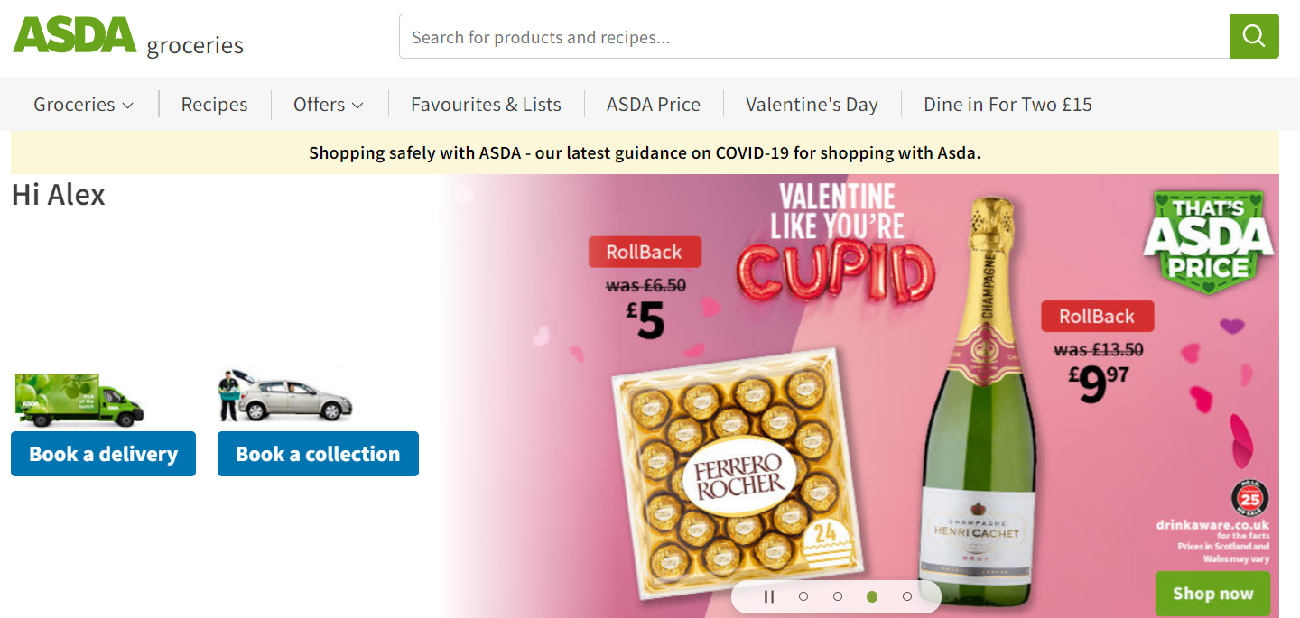
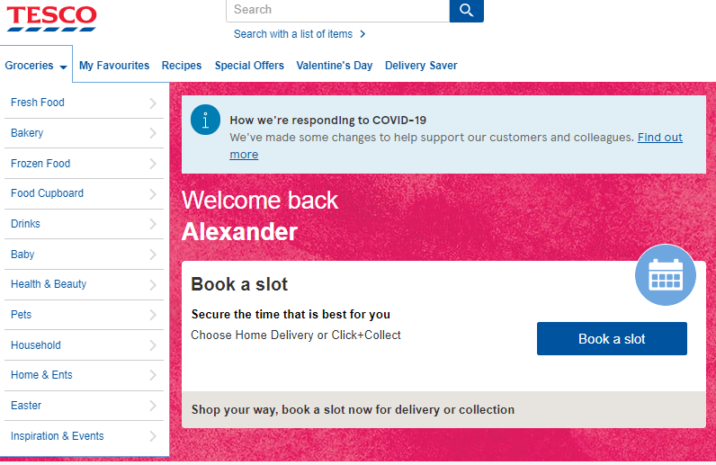
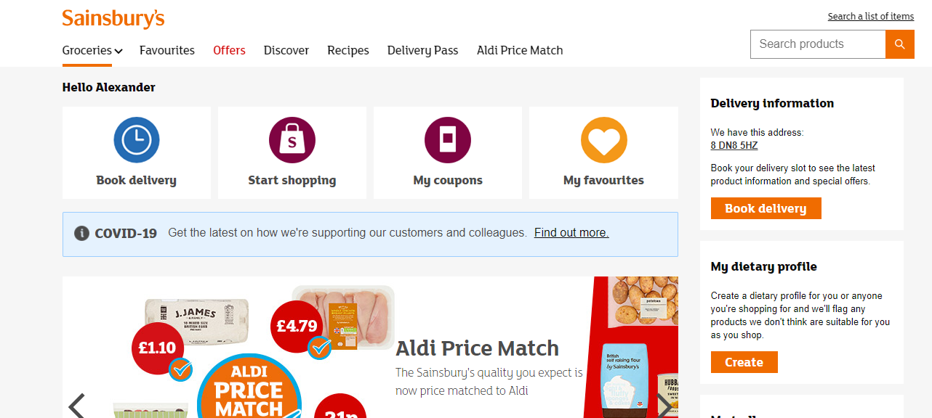
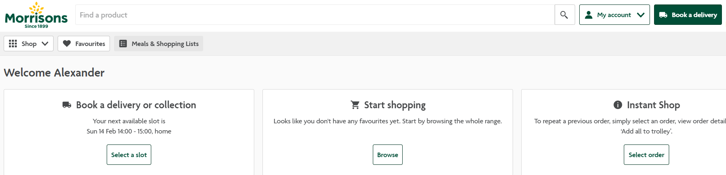
» Groceries Homepage
Back to index »
Platform Asda | Tesco | Sainsbury’s | Morrisons | Ocado | Waitrose | Iceland | Co-Op | AmazonFresh | Walmart
Focus: Book a slot, Seasonal, promotional, multiple product spotlights, recipes and movie nights in popup | Focus: Seasonal promo. Offers, promotional, product spotlight, recipes and content, Aldi price match. | Focus: Book a slot, start shop, coupons and favourites. Aldi price match. Seasonal offers, promos and product spotlight | Focus: Book slot start shop and instant shop. Seasonal and online exclusive menu | Focus: Offers, seasonal, long product list, promo. book slot & start shop. Offers, seasonal, product list removed | Focus: book slot & start shop, browse categories, long product list; book slot & start shop, product list | Focus: Book slot, Online exclusives, Promotional, popular categories, featured offers, no product lists. | Focus: Product spotlights | Focus: Horizontal scrolling product lists, multiple easy links to get shopping | Focus: Promotions, seasonal, services. Popular categories, offers, no product lists. Very visual.
Wismo, services, product spotlights.
Similar to rWeb but simplified. Tabbed product spotlights
Similar focus/content to D/MR, horisontal scrollling
Similar focus to D/MR, quick links, offers
App being turned back on slowly
App being turned back on slowly
No mobile app
No mobile app for groceries
Integrated into Amazon App
Not available in UK
Current Asda site
Variable content for Signed Out/Signed In (Personalised offers)
Book a delivery and book collection now taking primary focus for signed in customers
Carousel displaying seasonal promotions and offers
Recipes
Favourites list and sponsored products
Analytics
New Homepage re-design we saw 28% uplift in clicks through to slots page
Work In Progress / Testing
Trialling different Hero Banners

Slide 21
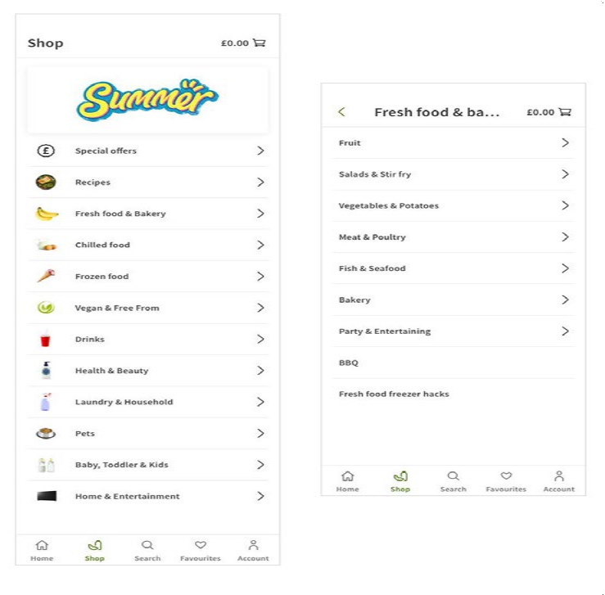
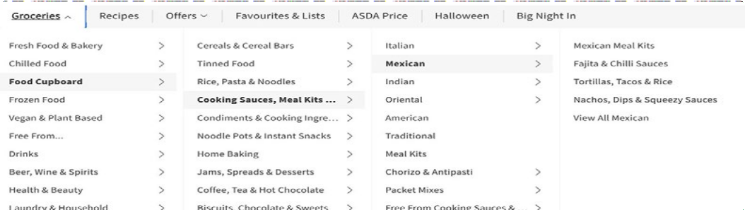
» Navigation
Back to index »
Platform Asda | Tesco | Sainsbury’s | Morrisons | Ocado | Waitrose | Iceland | Co-Op | AmazonFresh | Walmart
D: Scrolling, 4-level hover mega menu. MR: Drilldown nav. View all at aisle/shelf level, explore buttons | D: Scrolling, 3-level click mega menu. MR: Accordion nav. View all at dept level | D: Persistent, 3-level hover mega menu. MR: Drilldown nav. View all at cat/dept level | D: Persistent, 3-level hover mega menu. MR: Drilldown nav. View all at cat/dept level, featured links, | D: Persistent, 3-level hover mega menu. MR: Drilldown nav. View all at cat/dept level, featured links, | D: Persistent, 3-level click mega menu. MR: Drilldown nav. View all at cat/dept level | D: Scrolling, 3-level click mega menu. MR: Drilldown nav. View all at cat/dept level, featured links | Persistent, 2-level click accordion. View all at dept/aisle level, not accessible | D: Scrolling, 2-level hover dropdown, explore buttons, drilldown horisontal scrolling spotlights | D: Persistent, collapsed 2-level hover mega menu. MR: Drilldown nav
Drilldown nav, image/ text tiles | Drilldown nav, image/ text list | Drilldown nav, text list | Drilldown nav |  | 2-level drilldown nav, refinement, image/ text tiles | No mobile app | No mobile app | Footer pop-up horisontal scrolling | Not available in UK
App being turned back on slowly
Current site
Work In Progress / Testing
App Redesign
Desktop: 4 Level hover mega menu
Mobile Responsive: 4 level drilldown navigation
Mobile Apps: 4 Level drildown navigation, large accessible image and text tiles for easy navigation
Flexible number of categories/departments and variable taxonomy levels
View all at aisle/shelf level
Explore taxonomy buttons
Scrolling header and navigation, but persistent search bar
Analytics
Taxonomy accounts for 11% of total cart adds, flat vs. Q1.
Webapp only - 27% of total visits, down 1.5% vs. Q1
Mobile App navigation redesign – Research and UX design in progress
Potential
Reduce taxonomy depth/sub-categories and bring ‘view all...’ up a level –
Action: Engage Merchandising team to explore options
More attribute-driven taxonomy – Action: Include more taxonomy items to highlight attributes like value, nutrition, best in season, seasonal, recipes
Persistent navigation/header
Explore monetisation options for selected Mobile App navigation panels
Customer feedback trends
Customers find the navigation and taxonomy overly complex with too many sub-categories, making it time consuming and confusing to use
Customers ask for view all on more taxonomy levels with improved filters
Navigating/going back on the app is confusing and ineffective
Directly comparing our App navigation unfavourably with the Tesco App

Slide 22
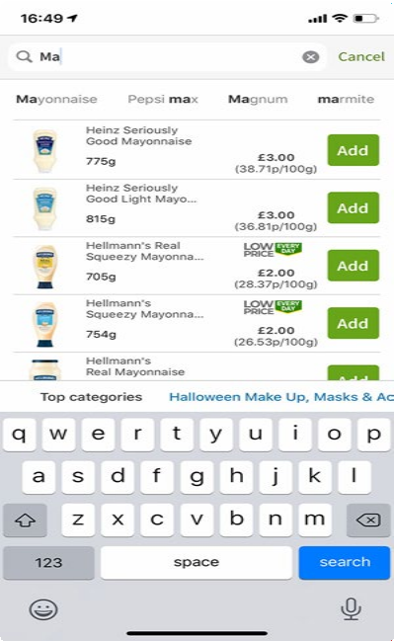
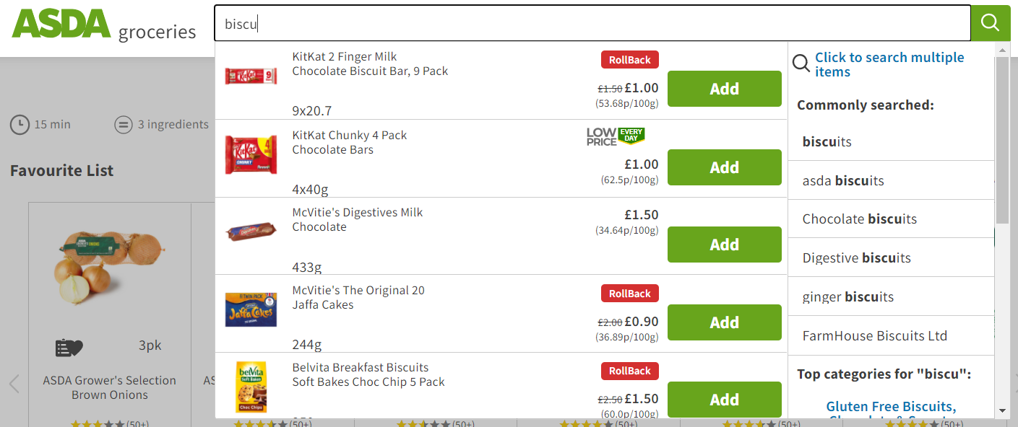
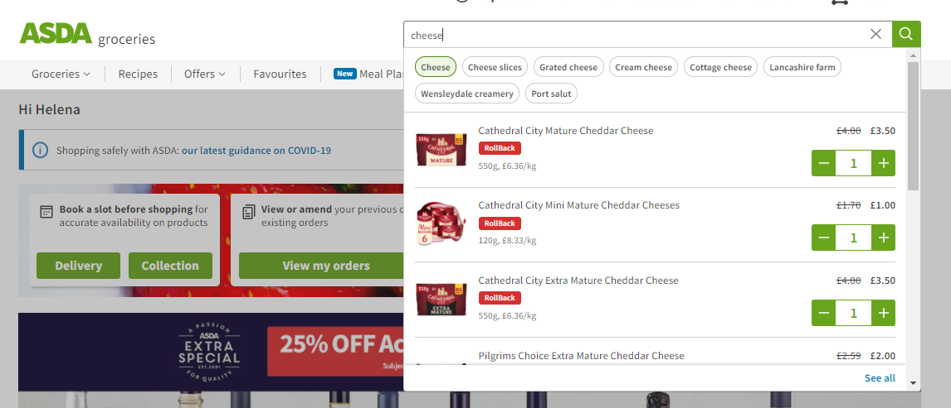
» Search
Back to index »
Platform Asda
Tesco
Sainsbury’s
Morrisons
Ocado
Waitrose Iceland
Basic auto-complete, Enhanced auto- auto-correct, multi- complete, auto- search, remove words correct, suggested
terms
Co-Op
AmazonFresh
Walmart
DRT, auto-correct, multi-search, recipe and product results. D: enhanced auto- complete.
MR: no EAC
Basic auto-complete, auto-correct, multi- search, excellent search refinement
Basic auto-complete, auto-correct, multi- search
D: Auto-complete, D: Basic auto- auto-correct, iterative complete, auto- search, related terms, correct, iterative
multi-search. MR: search, multi-search. Basic auto-complete MR: Basic auto-
only complete only
Basic auto-complete, auto-correct
Auto-complete, auto- correct
Auto-complete,
auto-correct, related brands, related search terms, rest of shelf
 | EAC, no multi-search, | No multi-search, scan barcode | No multi-search | No multi-search | App being turned back on slowly | No multi-search, voice No mobile app search | No mobile app | Integrated with Amazon app | Not available in UK
Current site
Migration to SOLr search engine complete
Lazy load up to 60 products, then pagination
Enhanced auto-complete on Deskktop and Mobile Apps, alllows the user to add products from header search overlay
Related searches now live on WebApp
Multi-search and multi-ingredient search
Spelling auto-correct
Recipes results from Search
Scan barcode functionality on Mobile App
Personalised search based on past orders
Redesign of EAC being tested
Potential
Improve sort and filter to refine search results – Action: improve search refinement, filter by ratings, favourites first, offers
Graphical filters
Include view rest of shelf or breadcrumb option in results
Include multi-search on Mobile App
Separate brands in commonly searched
App search and search results pages to be redesigned as part of the App rebuild – phase 3

Slide 23
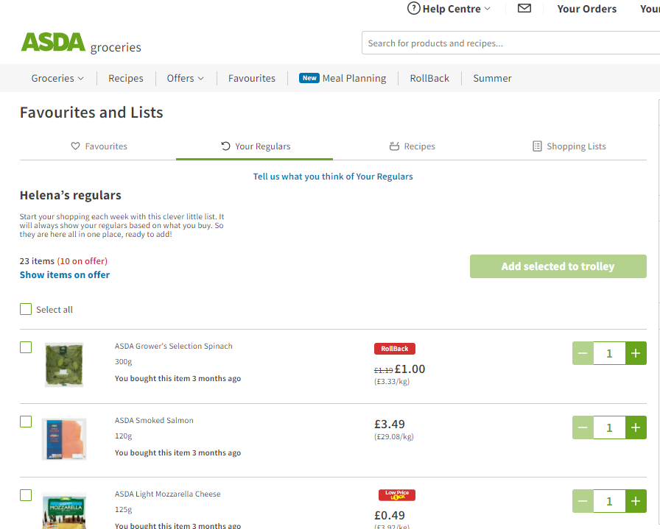
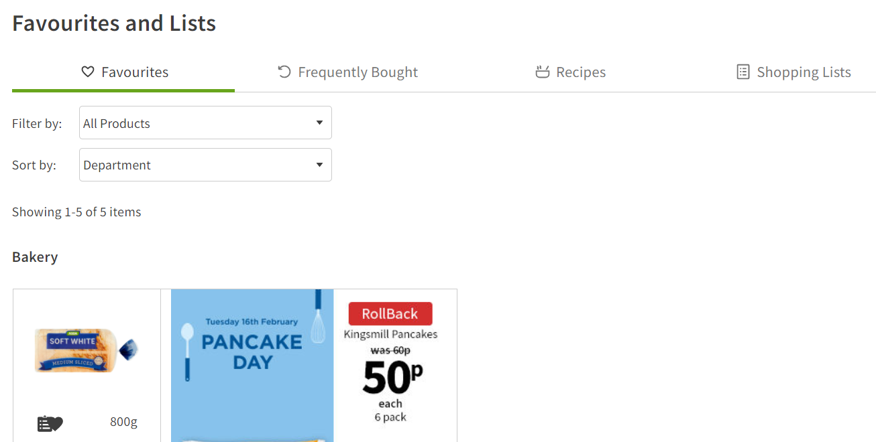
» Favourites and lists
Back to index »
Platform Asda | Tesco | Sainsbury’s | Morrisons | Ocado | Waitrose | Iceland | Co-Op | AmazonFresh | Walmart
Add from product, | Fav: Online/in-store | Nectar Card, | Add from product and | Add from product and | Add from product, | Add from product, | None | None | Add from product
favourited and | purchases from last | based on frequently | frequently bought | frequently bought | online/in-store | favourited items only. |  | Past Purchases – | to primary list, no
Your Regulars, | 13 months, filter by | bought items, | items, search for | items, search for | purchases, sort/filter, | Frequently Bought |  | previously bought | favourites page. Buy
recipes; sort/filter. | category. My Usuals | previous orders tab, | products, sort. User | products, sort. User | no frequently bought, | – items regularly |  | items. No shopping | again – previously
Shopping lists – | – items regularly | no shopping lists | created list with | created list with | shopping lists – add | purchased online. No |  | lists. | bought items.
Add from product, | purchased online |  | frequency setting, | frequency setting, | from PDP | shopping list |  |  | Shopping lists – add
highlight offers, add | Shopping lists – not |  | offers | offers |  |  |  |  | from PDP,
to basket | available, work in |  |  |  |  |  |  |  | search for products,
 | progress |  |  |  |  |  |  |  | collaboration
No regulars | Parity | No prev orders tab | App back on | App switched off | No shopping lists | No mobile app | No mobile app | None | Not available in UK
Current site
Favourites pages: Favourites, Your Regulars, Recipes and Shopping lists
Add directly to favourites or shopping list from product module
Favourites – Based on favourited items and items previously purchased online
*NEW* - Your Regulars now live on the site for webapp
Filter by department or purchase frequency
Monetisation in Favourites
Favourited recipes
Create and add products to shopping lists
Add entire shopping list or individual products to basket,
Analytics (webapp only)
31% of cart adds vs. 29% in Q1 (Your Regulars 70% of these cart adds)
Potential
Search within favourites and more refinement options
App favourites pages to be redesigned as part of the App rebuild – phase 3
Manually add products and frequency to regulars list
Search to add products to list
Sharing or collaboration on shopping lists
Clearer sign-posting to direct customers to shopping lists
Regulars for mobile app
Integrate more data into YR algo
Improved clarification for customers on the difference between YR and favourites

Slide 24
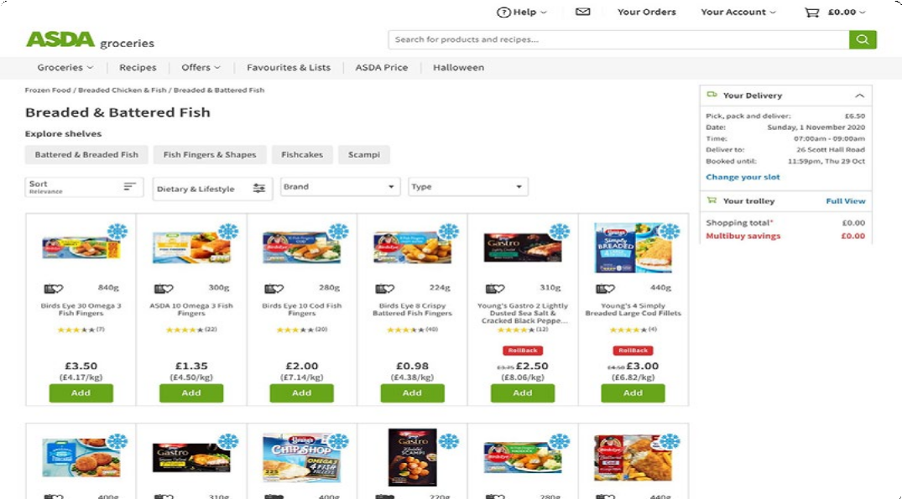
» Taxonomy and product list pages
Back to index »
Platform Asda | Tesco | Sainsbury’s | Morrisons | Ocado | Waitrose | Iceland | Co-Op | AmazonFresh | Walmart
60 products per | 24-48 products per | 48-120 products per | Lazy load, sort/filter, | Lazy load, sort/filter, | 48 products per page, | 24 products per page, | 16 products per | 24 products per page, | 40 products per page,
page, pagination, | page, pagination, | page, pagination, list/ | refinement links, | refinement links, | load more button, | pagination, sort/ | page, load more | pagination. sort/filter. | pagination, sort/
sort/filter, explore | sort/filter, | module view, sort/ | arranged by promo | arranged by promo | sort/filter, refinement | filter, popular brands/ | button, no filters, no | Product modules:- | filter, related brands/
and refinement links | recommendations. | filter. | type – offer/oos, new/ | type – favs, offer/oos, | links. | images, refinement | breadcrumb. | D: 4 per row. | searches/terms,
recommendations. | Product modules:- | Product modules:- | oos, all other/oos. | new/oos, all other/ | Product modules:- | links, list/module view | Product modules:- | MR: Defaults to App | refinement links, list/
Product modules:- | D: max 4 per row. MR: | D: max 4 per row. MR: | Product modules:- | oos. | D: max 6 per row. MR: | Product modules:- | D: max 4 per row. MR: |  | grid view.
D: max 6 per row. MR: | 1 per row | 1 per row | D: max 10 per row. MR: | Product modules:- | 1 per row | D: max 4 per row. MR: | 2 per row | Product Spotlight | Product modules:-
1 per row |  |  | 1 per row | D: max 10 per row. MR: |  | 1 per row |  | pages | D: max 5 per row. MR:
 |  |  |  | 1 per row |  |  |  | D: 7 per row | 1 per row
Product list, no sort/ | Lazy load product list, | Lazy load product list, | Lazy load product list, | App switched off | Lazy load product list, | No mobile app | No mobile app | 3 per row/view, | Not available in UK
filter/refinement, | sort/filter, simple, | sort/filter, | sort/filter, |  | sort/filter/refine, |  |  | horisontal scroll
2 products per row | 1 product per row | 1 product per row | 1 product per row |  | 1 product per row
Current site
Sitewidth increased to allow up to 6 products per row on larger viewports
Up to 60 products per page
Paginated
Dietary & Lifestyle and merchandising filters
Sort by relevancy, price
Recommendations and sponsored product spotlights
Analytics
11% of total cart adds can be attributed to Taxonomy. Of this, 57.8% and 36.8% of cart adds come from aisle and shelf respectively.
Potential
More comprehensive multi-select filters – Action: Improve multi-select filters
‘Load more’ button – Action: ‘Load more’ button to replace pagination on aisle/shelf
Shop pages to be redesigned as part of the App rebuild – phase 1

Slide 25
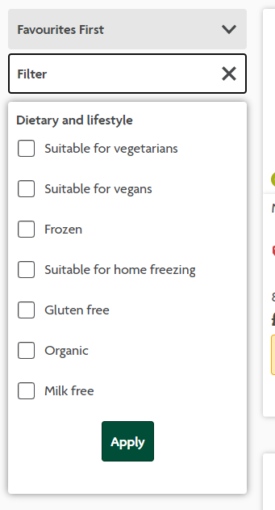
» Filters and sorting
Back to index »
Platform Asda | Tesco | Sainsbury’s | Morrisons | Ocado | Waitrose | Iceland | Co-Op | AmazonFresh | Walmart
Multi-select drop- | Collapse/expand | Collapse/expand | Multi-select left-side | Multi-select left-side | Multi-select filters | Multi-select left-side | None | Multi-select left-hand | Multi-select left-side
down dietary & | multi-select filters | multi-select filters | filters incl. brand, | filters incl. brand, | incl. Waitrose brand, | filters incl. price, |  | filters, review and | filters incl. brand,
lifestyle filters, single- | incl. category, brand, | incl. dietary & lifestyle, | dietary & lifestyle, | dietary & lifestyle, | dietary, offers; | brand, type/ flavour/ |  | price refinement | rating, price, offers,
select brand; sort incl. | new, offers and | type, brand, new, | new, offers; | new, offers, own | refinement links; sort | bigger pack; sort |  |  | type, dietary;
basic + nutritional; | favourites, single | offers and favourites; | sort incl. favs first, life | brand; sort incl. favs | incl. popular, rating, | incl. popular etc.; |  |  | refinement links incl.
drop-down modals | select dietary & | comprehensive sort | (short to long), rating, | first, life (short to | etc | refinement links; no |  |  | brands, related, store
require scrolling | lifestyle; basic sort | incl. favs first, popular, | etc | long), rating, etc |  | nutritional filters |  |  | availability; sort incl.
 |  | rating, new |  |  |  |  |  |  | popular, rating, new
 |  |  |  |  |  |  |  |  | etc.
Refine on search/ | Parity | Parity on filters, basic | Only sort available | App switched off | Parity | No mobile app | No mobile app | Basic Filters | Not available in UK
favourites pages only |  | sort
Current site
Potential
Morrison's
Basic sort by relevancy, price, brand, type – still lagging behind market
Drop-down modals require scrolling
Available on Aisle, Shelf, Search and Favourites
New recipes filters
Nutritional Filters available on taxonomy and search
Custom filters for different areas (e.g. Type, Size, Variety)
Mobile app – refine on search/favourites, none on taxonomy pages
Possible collapse expand filters
and/or logic options improvement
Improve Sort and filter to include favourites first, ratings, popular, value (price per unit/weight), unavailable or out of stock items, product life, new, offers
Customer feedback trend
Better/more comprehensive sort and filter functionality on all product listing pages, inlcuding search resutls and favourites pages
Sort, ratings, value (price per unit/weight),
Filter out unavailable or out of stock items

Slide 26
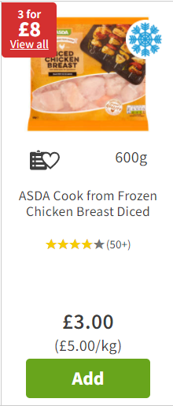
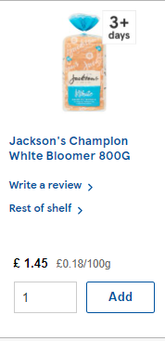
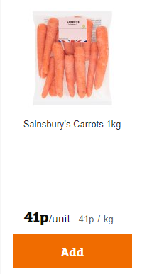
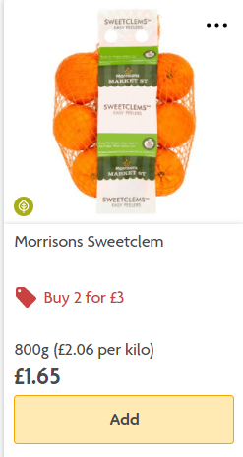
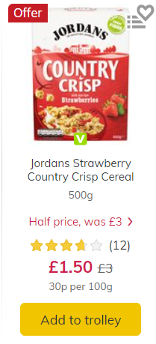
» Product module
Back to index »
Platform Asda | Tesco | Sainsbury’s | Morrisons | Ocado | Waitrose | Iceland | Co-Op | AmazonFresh | Walmart
Multiple add, clear | Multiple add - clear | Multiple add, | Multiple add, | Multiple add, | Multiple add - clear | Multiple add, | Multiple add, | Single add, rating, | No CTA/Add option
promos, iconography, | affordance, promo | promo details, limited | promo details, limited | promo details, limited | affordance, | promo details plus | promo details, | promo detail, | - add from PDP,
rating links to review | details, limited | iconography, rating/ | iconography, rating – | iconography, rating | promo details, rating, | linksave reminder, | D: variable width; | D: variable width; | rating, promo detail,
on PDP, add to favs/ | iconography, link to | write a review, dietary | no totals links to PDP, | links to PDP, add to | add to favourites, | rating, add to | OOS/Unavailable: | OOS/Unavailable: | availability for
list, D: variable width. | rest of shelf, write | profile warning, D: | add to favs/list, | favs/list, | D: variable width; | favourites, | None displayed | None displayed | delivery/collection,
OOS: Flag + alt, | a review, variable | variable height, fixed | D: variable width; | D: variable width; | OOS/Unavailable: | D: variable width; |  |  | D: variable width;
Unavailable: Flag only | width/ height, call out | width; | OOS/Unavailable: | OOS/Unavailable: | None displayed | OOS/Unavailable: Flag |  |  | OOS/Unavailable:
 | Aldi price match; | OOS/Unavailable: | Flag and link to | Flag and link to |  | only |  |  | None displayed
 | OOS/Unavailable: | None displayed | alternatives | alternatives
 | Flag, link to rest of
 | shelf, why not try
Parity, 2 per row; | Multiple add, promo | Multiple add, | Multiple add, | App switched off | Multiple add, promo | No mobile app | No mobile app | Parity | Not available in UK
OOS/U: Alternative | details, limited | promo details, dietary | promo details, dietary |  | details, rating, add
link | iconography only; | profile warning; OOS/ |  |  | to favourites; OOS/
 | OOS/U: Flag only | Unavailable: None |  |  | Unavailable: None
Current site
Clear promotional information
Iconography
Reviews
Add to favourites and lists
Variable width
Asda
Tesco
Sainsburys
Morrisons
Ocado
Potential
Reduced icon clutter
Improve CTA UX/Affordance for adding products – Action: Investigate options to add multiple products, text input field, reduce clicks
Link to rest of Shelf – Action: Test the impact of adding a link to the product module to view the rest of the shelf
Customer feedback trend
Add button is unfriendly for adding multiples, allow editable field to add quantity before clicking Add, or auto-select quantity field for ease of editing once button is clicked
Product description text too small to read
Alternatives or rest of shelf link
OOS when ordering weeks in advance

Slide 27
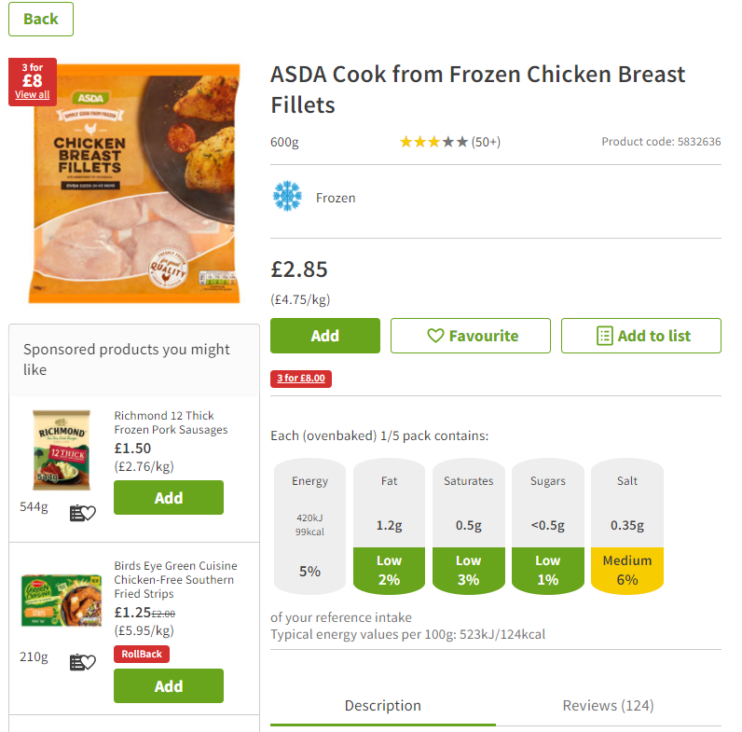

» Product detail page
Back to index »
Platform Asda | Tesco | Sainsbury’s | Morrisons | Ocado | Waitrose | Iceland | Co-Op | AmazonFresh | Walmart
Image zoom, no | Simple image enlarge, | Simple image enlarge, | Image enlarge, | Image enlarge, | Simple image enlarge, | Simple image enlarge, | Product info, | Image zoom, multiple | Image zoom, multiple
breadcrumb, | nutritional, rating and | rating and reviews, | nutritional, icons, | nutritional, icons, | add to favs/list, | add to favs, | nutritional | product images, rating | product images.
add to favs/list, | reviews, product Info, | product Info, | recommendations, | recommendations, | nutritional, | nutritional, rating and |  | and reviews, customer | Ratings, reviews,
nutritional, icons | recommendations, | nutritional | sponsored products, | sponsored products, | rating and reviews, | reviews, |  | questions, product | aspect filters,
recommendations | view rest of shelf |  | rating and reviews, | rating and reviews, | product info, limited | product info, |  | info, nutritional, | comments. Add to
rating and reviews, |  |  | product info, related | product info, related | iconography | recommendations |  | recommendations, | lists. Link to brand list
product info, branded |  |  | tags, recipes, report | tags, recipes, report |  |  |  | branded content, | and related products,
content |  |  | incorrect info, add | incorrect info, add |  |  |  | report incorrect info, | recommendations.
 |  |  | to favs/list, add to | to favs/list, add to |  |  |  | more ways to buy | Nutritional. Report
 |  |  | regulars, PDP sub-nav, | regulars, PDP sub-nav, |  |  |  | (Morrisons) | incorrect info. Icons
 |  |  | monetisation | monetisation
Image enlarge, no branded content | No rating/reviews/ | No rating/reviews or recommendations | No rating/reviews or recommendations | App switched off | Similar, works better | No mobile app | No mobile app | Parity | Not available in UK
Current site
Image zoom
Add to Favourites/Shopping list
Nutritional information
Recommendations
Ratings / Reviews
Product and manufacturer Info
Asda
Tesco
Work In Progress / Testing
Tags linking to rest of shelf and breadcrumbs in discovery and research
Potential
Product detail pages to be redesigned as part of the App rebuild – phase 1
PDP redesign with cartridge for base variance functionality / interactive features and variant information e.g. Cosmetics colours, Wine varieties – Action: Investigate viability of developing base variance
Tags linking to related product types e.g. gluten free, Mexican, vegan – Action: Test the impact of including tags linking to related taxonomy, product types, dietary & lifestyle
Add related recipes – Action: Include recipes related to the product via the P13N work stream to increase drivers to our recipe offering

Slide 28

» Recipes
Back to index »
Platform Asda
Tesco
Sainsbury’s
Morrisons
Ocado
Waitrose Iceland
Co-Op
AmazonFresh
Walmart
Add to basket, adjustable servings, save to favourites, personalisation, recommendations
Opens in new tab, add to basket, static servings, add to list/binder, share/ print, comments, recommendations, weekly set meal plans
Add to basket or list, static servings, cheap/standard/ premium option, user ideas for variations, meal -planning, method videos, scrapbook
Add to basket, static servings, pin/share/print recipe, recipe finder filter, pin recipe
Add to basket, static servings, pin/share/print recipe, recipe finder filter, pin recipe, recipe ratings & reviews
No add functionality, static servings, print/share recipe, save to scrapbook, recipe ratings
No recipe service
No recipe service
No add all items functionality – can add separately static servings
No add functionality, static servings, pin/ print/share recipe, includes recommedations for related GM items/ tools/appliances
 | Parity | None on Apps in UK | None on Apps, HP driver directs to web | None on apps | App switched off | None on apps No mobile app | No mobile app | None on Apps | Not available in UK
Current site
Potential
Add to basket directly from recipe
Adjustable servings
Favourite Recipes
Recipe Inspiration cartridges on homepage and taxonomy pages
improvement to search – recipe results shown instead when no product results
Option to print, share or save to personal collection
More everyday / economical recipe collections – Action: Apply research findings
Improve filters – Action: UX improvements and standardisation for recipe filters.
Recipes on PDP pages – Action: Include in PDP redesign discovery and research
Work in Progress
Recipes improvements – landing page, improved taxonomy
Recipes landing page redesign
Recipes ingredient mapping improvements
Meal Planning in A|B testing

Slide 29



» Recommendations
Back to index »
Platform Asda | Tesco | Sainsbury’s | Morrisons | Ocado | Waitrose | Iceland | Co-Op | AmazonFresh | Walmart
Personalised – | Simple – usually | Simple – top rated, | Personalised – you | Personalised - you | Featured, offers, | Simple – featured | Simple – featured | SImple – New/ | Ideas, inspiration,
customers like you, | bought next, | discover, future | might also like; | might like, similar, | inspiration, BYG up- | offers, popular | products/promo, top | sponsored/featured/ | seasonal offers, best
offers, top sellers, BYG Your regulars, | promoted offers | brands, new & trending | recipes on PDP, offers, selected shops, BYG | recipes on PDP, offers, inspiration & brands, BYG | sell | categories | offers | trending | sellers, featured brands and related finds, buying guides
Parity – No YR on mobile apps, | None on Apps | Similar, localised, no content just products | None on App | App switched off | Similar, localised, access from nav | No mobile app | No mobile app | Parity | Not available in UK
Current site
Site-wide recommendations powered by in-house solution
Personalised to each customer
Filters out cart and page products
Potential
Customer feedback to tailor recommendations
Account preference settings or segmentation to better target recommendations (e.g. vegetarian)

Slide 30

» Content
Back to index »
Platform Asda
Tesco
Sainsbury’s
Morrisons
Ocado
Waitrose
Iceland
Co-Op
AmazonFresh
Walmart
 | Content throughout | Mainly localised | Some content in Content throughout Little integration in | Some integration | Some content | Very little content of | Simple but effective, | Very little content
 | the site, integrated in | accessible from nav, | taxonomy pages, the site, integrated in taxonomy pages. | in taxonomy pages, | integration in | any kind. Currently | image panel drivers | integration in
 | taxonomy PLPs, PDPs | little integration in | image drivers on taxonomy and content Mostly localised | limited subtle image | taxonomy, image | only one on site, | to product lists, | taxonomy, localised to
 | and content pages. | taxonomy pages. | seasonal pages pages. Templated Shop/content pages. | drivers present. | links on seasonal | competition with | simple image headers. | brand pages and Ideas
 | Templated media | Templated pages/ | to product listing header and image Distinct gallery | Localised content | event pages driving to | simple header and | Follows similar layout | inspitration pages.
 | and coded content | elements with same | pages - templated link content relatively template with some | seems relatively | product listing pages - | product list | throughout. | Very visual, simple,
 | structure, flexible richtext templates, expandable media. Video content. | layout format, images drivers to content pages with product spotlights. | format. Gallery type a flexible format flexibility in the inspirational content/ to accommodate arrangement of images including user images, keeps to a images, links and created content. Video similar style, bespoke colourways. content. colorways | flexible in layout, following a distinct visual style – predominantly using images | templated format |  | Content on PDP | clear – static images, text, links to shop. Accessible design principles. Felxible but follows distinct styleguide
 | Stripped back content throughout the app, image based, no rich text | None on Apps | None on Apps None on App App switched off | Image headers throughout, no other content | No mobile app | No mobile app | Parity | Not available in UK
Current site
Potential
Funded and corporate promotion and event content throughout the site
integrated in taxonomy PLPs, PDPs and content pages.
Templated banner media
Templated coded content structure, flexible richtext templates
Expandable media through Undertone
Video content on PDPs and content pages
Improve UX and Accessibility on all content
More merchandising content related to attribute driven taxonomy
More temporary and semi-permanent funded content
Innovation in content features and offering e.g. 3D product images on selected PDPs

Slide 31



» Registration
Back to index »
Platform | Asda | Tesco | Sainsbury’s | Morrisons | Ocado | Waitrose | Iceland | Co-Op | AmazonFresh | Walmart
All | Single email and | Single email and | Multi-step process, | Register with | Register with | Full details required, | Full details required, | 2x Email and 2x | Name, email, 2x | Name, single email
 | password, strength | password, full details | external email | Facebook/AppleID, | Facebook/Paypal/ | postcode check, 2x | postcode check, single | password,full | password, email | and password, opt-in
 | checker, postcode | required, | verification, full | postcode check, full | AppleID, single email | email and single | email and password, | details required for | verification OTP, | marketing choice auto
 | only - remaining | multiple opt-in | details required, | details, single email | and password, name, | password, multiple | opt-in marketing | membership,opt-in | remaining details on | selected, remaining
 | details in account | marketing choices - | opt-in marketing | and password, opt- | postcode, opt-in | opt-in marketing | choice auto selected, | marketing | log-in | details in account or
 | or checkout, opt-in | some auto selected | choice | in marketing choice, | marketing choice | choices | reCAPTCHA |  |  | checkout
 | marketing choice |  |  | reCAPTCHA
Current site
Asda
Morrisons
Ocado
Simplified process – single registration form
Only ask for email + password once
Password strength checker
Clear opt-in marketing choice
Potential
Streamline postcode check leading up to registration process – Action: Reduce the number of times a customer is required to enter their postcode, currently this is asked for three times

Slide 32

» Mini trolley
Back to index »
Platform Asda | Tesco | Sainsbury’s | Morrisons | Ocado | Waitrose | Iceland | Co-Op | AmazonFresh | Walmart
Fixed to side – | Fixed to side – | Fixed to side – | Drop-down from | None, trolley totals | Side pop-out, product | Side pop-out, slot | None, trolley total in | Fixed to side - static, | None, button in
scrolling, slot info, | scrolling, slot info, | scrolling, offer | header, product | in header, button to | images | info, missed offers, | header links to basket | product images, | header links to full
missed offers | missed offers, product | indication, separate | images, slot info, no | see full trolley page, |  | product images, no | page, no empty trolley | details on hover, no | trolley page, no empty
 | image, sub/note | slot info. Save trolley | promo or missed offer | product images |  | empty trolley option | option | empty trolley option | trolley option
 |  | option | info
Full trolley overlay, | Full trolley overlay, | Full trolley page, | Full trolley page, | App switched off | Trolley page, slot | No mobile app | No mobile app | Full trolley page, | Not available in UK
slot info, product | slot info, product | no slot info, product | no slot info, product |  | info, product image, |  |  | product images, no
images, missed offers | images, missed offers, | images, offer | images, offer |  | missed offers, sub/ |  |  | slot info
 | sub/note | indication | indication |  | note, add to fav
Current site
Visibility of products being added
Sticks in view on scroll
Highlights complete/incomplete offers
Minimum order notifications
Delivery slot information
Collapsible sections
Monetisation and recommendations
Recipes in trolley
Analytics
Less than 1% of cart adds are made from the mini trolley, it is mostly used to remove items already in the trolley
Customer feedback trend
On app, there is no proceed to checkout at the bottom of the list only empty trolley, lost whole shop by accident
More clear way of flagging product exceptions in the trolley, OOS, offers
Save or print trolley contents to take as a list when there are no online slots
Work In Progress / Testing
Mini-trolley + slots drawer concept to start discovery in Q4
Potential
Product images – Action: Include product images as part of the mini-trolley redesign, to improve customer experience
Slide in trolley drawer

Slide 33

» Book slot
Back to index »
Platform Asda | Tesco | Sainsbury’s | Morrisons | Ocado | Waitrose | Iceland | Co-Op | AmazonFresh | Walmart
Fixed 1-2 hour slots, | Fixed or flexible 1-4 | Fixed slots, 1 hour | Fixed 1 hour slots, 3 | Fixed 1 hour slots, | Fixed 1 hour slots, 5 | Fixed 2 hour slots, | Fixed 1 hour slots, | Fixed 1-2 hour slots, | Assigns next available
4 day view, 21 day | hour slots, 7 day | window, 7 day view, | day view, split by time | 3 day view, 3 day | day view, split by time | 1 day view, 5 day | 5 day view, 5 day | 1 day view, 4 day | date, no slots to
horison, recurring slots | view – tabbed, 21 day horizon. £4.50 for 1hr, £3 flexi | split by time of day, 7 day horizon. £4 for 1hr, £1 for saver | of day, 21 day horizon. £2-6 per slot | horison, Ocado Reserved recurring £2.99 – £6.99 | of day, 15 day horizon. Free delivery | horizon | horizon. Limited to specific areas | horizon | choose
3 day view | 1 day view – tabbed | 1 day view – tabbed | 3 day view - tabbed | App slowly rolling out | 3 day view | No mobile app | No mobile app | Parity | Not available in UK
Current site
3-week availability
4 days visible
1-2 hour slots
Interactive C&C location picker
Clear pricing
Market-leading delivery pass
Recurring slots
Customer feedback trend
Journey to change or cancel a slot is unclear
Add a reschedule or cancel button
Work In Progress / Testing
Mini-trolley + slots drawer concept to start discovery in Q4
Potential
App slots pages to be redesigned as part of the App rebuild – phase 2
Split by Morning/Afternoon/Evening
More days visible per view
Flexible slots/Express slots/1 hour slots
increase to 4 day advance per pagination/tab not 1 day per click

Slide 34

» Before you go
Back to index »
Platform Asda | Tesco | Sainsbury’s | Morrisons | Ocado | Waitrose | Iceland | Co-Op | AmazonFresh | Walmart
Incomplete offers, | Incomplete offers, | Sponsored | Incomplete offers, | Incomplete offers, | Incomplete offers, | Incomplete offers, | None | Recommendations, | None
past orders items, sponsored products, some scan and go integrations; | substitutions | recommendations | recommendations, new/offers/sale, OOS for slot/sub | recommendations - offers/flash sale | missed favourites, before you go up-sell | forgotten favourites, frequently bought |  | offers
Incomplete offers, past orders items | Incomplete offers | None | Incomplete offers/Missing items | App switched off | None | No mobile app | No mobile app | Parity | Not available in UK
Current site
Recommendations driven by P13N
Incomplete Offers briefly highlighted then moves down the page
Search bar allows adding missing products directly
Trolley Changes / Substitution follows
Dependent on eligibility, customers are also shown recommendations based on past Scan and go shops
Customer feedback trend
BYG checkout delivery impact pop-up - Customers find it frustrating that items show as in stock on product modules but as out of stock only seconds later during checkout.
Potential
App slots pages to be redesigned as part of the App rebuild – phase 2
Multiple recommendation strategies
Dedicate steps to missed offers, sponsored products, offers, flash sales –
Action: explore options to include additional steps into BYG to drive sales
Delivery impact improvement with all areas of the site on RTSC possibly

Slide 35

» LinkSave reminders
Back to index »
Platform Asda | Tesco | Sainsbury’s | Morrisons | Ocado | Waitrose | Iceland | Co-Op | AmazonFresh | Walmart
Mini trolley reminder, checkout, incomplete offers | Mini & full trolley reminder, checkout | Trolley reminder, checkout | Checkout reminder | Checkout reminder | Full trolley page, checkout, incomplete offers | Product module, mini & full trolley reminder, checkout | None | None | None
Trolley | Trolley, Checkout | None | Trolley | App switched off | Trolley | No mobile app | No mobile app | None | Not available in UK
Current site
Strong in marketplace
Multiple reminders across different points of the journey
Helps drive sales
In BYG the reminder displays for a second, then shifted down the page - CLS
Potential
Include in full trolley view
Inlude on product modules
Improve the experience in BYG
Dedicate a step in checkout to driving incomplete and other offers

Slide 36
» Checkout
Back to index »
Platform | Asda | Tesco | Sainsbury’s | Morrisons | Ocado | Waitrose | Iceland | Co-Op | AmazonFresh | Walmart
All | 3-4 Step process; | 3-5 Step process; | 5 Step process, steps | 5 Step process; | 8 Step process, steps | 4-5 Step process, | 4 Step process; | 3 Step process; | 3-7 Step process; | 3-4 Step process;
 | Payment methods: | Payment methods: | dedicated to offers; | Payment methods: | dedicated to offers, | steps dedicated to | Payment methods: | Payment methods: | Payment methods: | Payment methods:
 | Credit or Debit cards | Credit or Debit cards | Payment methods: | Credit or Debit cards | upselling; Payment | upselling; Payment | Credit or Debit cards | Credit or Debit cards – | Credit or Debit cards | Credit or Debit cards
 | – Visa, Mastercard, | – Visa, Mastercard, | Credit or Debit cards | – Visa, Mastercard, | methods: Credit or | methods: Credit | – Visa, Mastercard; | Visa, Mastercard | – Visa, Mastercard, | – Visa, Mastercard,
 | Maestro, Amex; Gift | Maestro, Amex, Tesco | – Visa, Mastercard, | Amex; Morrisons | Debit cards – Visa, | or Debit cards – | Paypal |  | Amex, Delta, Euro, | Amex, Discover,
 | cards, Asda eVouchers | Bank; Clubcard Plus, | Maestro, Amex; Nectar | Vouchers or Coupons | Mastercard, Amex, | Partnership card, Visa, |  |  | Maestro, Solo; | Walmart Moneycard;
 |  | Clubcard vouchers | points, Sainsbury’s |  | Switch; PayPal, Ocado | Mastercard, Maestro, |  |  | Amazon gift cards and | Walmart Gift/eGift
 |  | and eCoupons | Gift Cards, E-Gift |  | coupons | Amex; Waitrrose Gift |  |  | vouchers, Rewards | cards, PayPal, Chase
 |  |  | Cards Coupons and |  |  | cards, and vouchers |  |  | points | Pay, Visa Checkout,
 |  |  | Vouchers |  |  |  |  |  |  | Amex Express
 |  |  |  |  |  |  |  |  |  | Checkout, Pay in
 |  |  |  |  |  |  |  |  |  | person in-store, Affirm
 |  |  |  |  |  |  |  |  |  | Installment Financing
» Accessibility
Platform Asda | Tesco | Sainsbury’s | Morrisons | Ocado | Waitrose | Iceland | Co-Op | AmazonFresh | Walmart
All Work in progress to | WCAG AA compliant, | WCAG A and AA | Work in progress | Work in progress | Work in progress | WCAG status | WCAG status | WCAG status | WCAG AA compliant,
meet WCAG AA, | statement on site | compliant, statement | to meet WCAG A, | to meet WCAG A, | to meet WCAG AA, | unknown, no | unknown, no | unknown, content on | statement on site
no statement |  | on site | statement on site | statement on site | statement on site | statement | statement | site

Slide 37
» Third-party tools – voice of customer/analytics/testing tools
Back to index »
Platform Asda Tesco Sainsbury’s Morrisons Ocado
Waitrose
Iceland
Co-Op
AmazonFresh
Walmart
All Ratings & Reviews: | Ratings & Reviews: | Ratings & Reviews: Ratings & Reviews: | Customer Insight: | Ratings & Reviews: | Ratings & Reviews: | Session Replay: | In-house solutions/ | In-house solutions/
Bazaar Voice. | Bazaar Voice. | Bazaar Voice. Bazaar Voice | Orlo | Bazaar Voice | Feefo | Content Square | hidden | hidden
Customer Insight: | Customer Insight: | Customer Insight: Analytics: | Analytics: | Customer Insight: | Customer Insight: | Analytics:
Verint Opinion Lab. | Verint Foresee. | Service Management Google Analytics. | Google Analytics, | Maru-EDU. | UserZoom. | Adobe Analytics,
Session replay: | Analytics: | Group. Observability: | Quantcount. | Analytics: | Session Replay: | Google Analytics.
Decibel Insight. | Adobe Analytics, | Session Replay: New Relic. | Tag manager: | Google Analytics. Tag | Content Square | Tag manager:
Analytics: | AppDynamics, Google | Content Square A/B testing: | Google Tag Manager. | manager: | Analytics: | Ensighten
Adobe Analytics, | Analytics. | Customer interaction/ No visible tag, | Observability: | Google Tag Manager. | SOASTA mPulse,
Google Analytics. | Tag manager: | P13N: Peerius, [24]7. possibly server-side | New Relic. | A/B testing: | Google Analytics.
Tag manager: | Google Tag Manager. | Observability: Advertising: | A/B testing: | Monetate | Tag manager:
Signal. | A/B testing: | New Relic. Criteo, | No visible tag, |  | Google Tag Manager.
Observability: | No visible tag, | Tag manager: [m]Platform, | possibly server-side
Splunk. | possibly server-side | Tealium. HookLogic.
A/B testing: |  | A/B testing:
SiteSpect. |  | Monetate.
Advertising:
Criteo, HookLogic.

Slide 38






» Recipes landing page – UX improvements
Back to index »
UX Design / Work in Progress
UX Design: https://zpl.io/29xkE9B »
User Research in progress, development planned for Q4
Objectives
To find an approach to improve engagement and overall customer experience
To test options that may provide customers with a more personalised and
To test functionality that may assist customers to search within recipes and
on the recipes landing page
focused landing page to simplify exploring recipes
filter their results in a more effective way

Slide 39



» Competitor mobile apps status
Back to index »
Ocado
– switched off since late September
Iceland
– no mobile app
Co-op
– no mobile app for food shopping

